Slide 1
Fundamentals and Basics: Codebook
Session 2: Codebook Overview and Python libraries

Slide 2
Table of contents
03 Why is Python Popular? 04 Codebook Overview 05 Codebook: Access and Navigation 06 Python Libraries 07 Using Python Libraries 08 Available Python Libraries in Codebook 10 Codebook Example: Import and Run 11 More Codebook examples: Comment/Run/Find

Slide 3
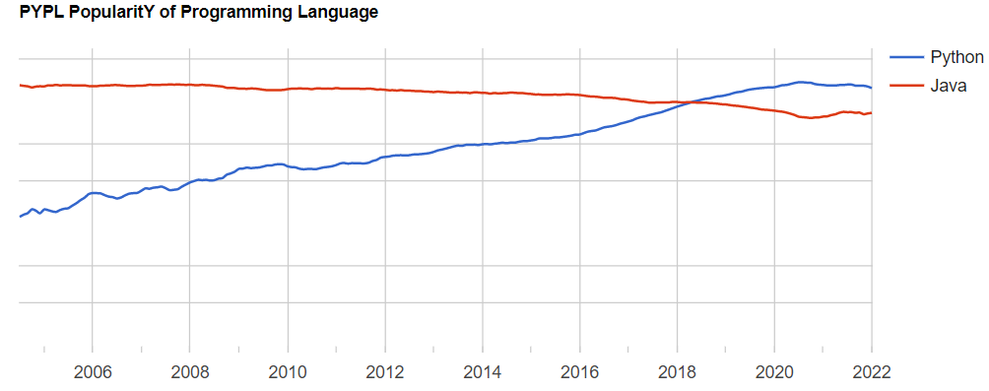
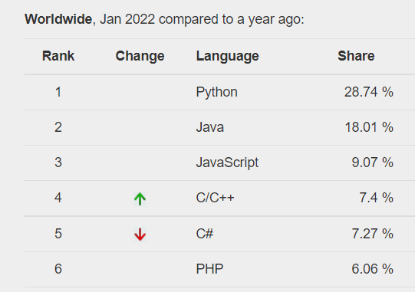
Why is Python Popular?
Python is one of the languages that is witnessing incredible growth and popularity year by year. PYPL (PopularitY of Programming Language Index) scores Python as the most popular and the fastest-growing (17.6% during last 5 years) language, based on search engine searches for various programming languages.
There are multiple reasons for popularity of Python, among which are:
Good Choice for beginners: easy-to-learn which reads/writes like a plain English text
We are leaving in the era of Big data and Python is great in dealing with it: go to language for data analytics, ML and AI applications
It is open source: free and constantly being improved along with hundreds of libraries and frameworks
A lot of free and accessible materials: Python documentation, ebooks, stack overflow, other web resources
https://pypl.github.io/PYPL.html
Notes:
https://pypl.github.io/PYPL.html
https://www.upgrad.com/blog/reasons-why-python-popular-with-developers/
https://media.ed.ac.uk/media/1_9c3vbwdq

Slide 4
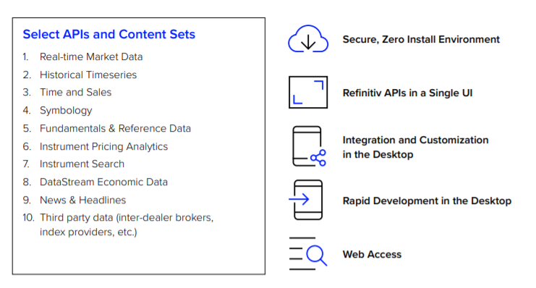
Codebook Overview
Codobok enables access to a cloud-hosted development environment for Python scripting, enabling to leverage the Refinitiv Data Platform APIs and rapidly build/deploy models, apps and analytics.
Access from anywhere: CodeBook can be launched from any laptop or mobile device providing instant access to the Python models, all on: https://eikon.refinitiv.com/login
Build workflows in Layouts: You can embed CodeBook into your layout tiles just like any other app.
Customize charting: CodeBook contains different charting libraries offering customizable visualization formats
Create custom interactive apps: CodeBook can be used to create custom, interactive applications
Notes:
https://www.refinitiv.com/en/products/codebook
https://www.refinitiv.com/content/dam/marketing/en_us/documents/fact-sheets/codebook.pdf?_ga=2.31569918.1955858559.1642176209-1566115568.1642176209

Slide 5
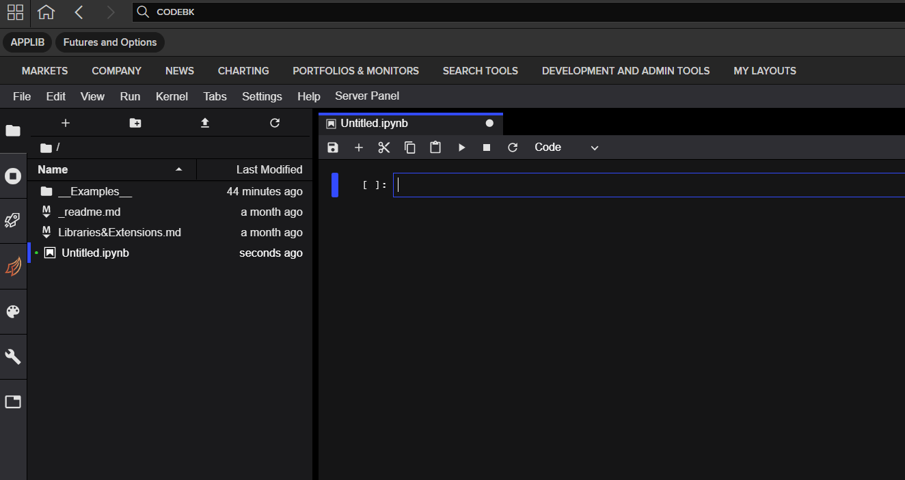
Codebook Access and Navigation
You can access Codebook via both Workspace Desktop App and Workspace Web app by typing Codebook in the search box:
Main Work Area – Code Console:
This area enables to write and debug the Code.
Add new Code Console by clicking + in the file browser
Run Code using Shift + Enter or clicking Play symbol in the file browser.
Menu Bar: The menu bar has top-level menus that expose actions available in CodeBook
Left Sidebar: The left sidebar contains a number of commonly-used tabs, such as a file browser where various examples covering different content (historical, real-time, news etc) can be found.
Shift between Code and Markdown cells:
Code: type and run code interactively
Markdown: contains text formatted using Markdown. Edit by double-clicking on them.
Notes:
https://jupyterlab.readthedocs.io/en/stable/user/interface.html
https://jupyterlab.readthedocs.io/en/stable/user/code_console.html

Slide 6
Python Libraries
Python libraries are a collection of codes or modules of codes that eliminate the need for writing codes from scratch. Python libraries play a vital role in developing machine learning, data science, data visualization, image text and data manipulation applications, and more.
Libraries for Mathematical and Scientific computation:
Numpy: Numpy is the fundamental package for scientific computing with Python. It consists of in-built mathematical functions for easy computations and is widely used in data analytics.
Scipy: Scipy is used for high-level scientific computations. It is built over an extension of Numpy and works with the latter to handle complex computations.
Libraries for data structuring and visualization:
Pandas: Pandas is a module which allows the construction of a dataframe, an object to store data that looks a little like a spreadsheet. Pandas provides flexible high-level data structures and a variety of analysis tools. It eases data analysis, manipulation, and cleaning.
Matplotlib, Seaborn: These are data visualization modules which allow drawing attractive and informative statistical graphics. These modules allow designing charts, graphs, pie charts, scatterplots, histograms, error charts, etc. with just a few lines of code.
Plotly: Plotly is also a data visualization tool as the ones mentioned above. However, this offers interactivity of the plots and is widely used in Machine Learning (ML) and National Language Processing (NLP) applications.
Libraries for ML and NLP:
Scikit-learn: Scikit-learn is an open-source library that is effectively used for various ML applications, including supervised and unsupervised algorithms like regression, classification, clustering, etc.
TensorFlow: A library developed by Google which is widely used by researchers for machine learning and deep learning algorithms, and by physicists for complex mathematical computations.
NLTK: NLTK package is widely used in NLP applications. It presents a practical introduction to programming for language processing. NLTK comes with a host of text processing libraries for sentence detection, tokenization, lemmatization, stemming, parsing etc.
Notes:
https://www.mygreatlearning.com/blog/open-source-python-libraries/
https://www.geeksforgeeks.org/libraries-in-python/

Slide 7
Using Python Libraries
In order to make use of Python libraries, we need to:
Install the libraries using PIP as follows:
Import Libraries, as follows:
Module names are typically abbreviated, in order to avoid cluttered code, for example, `pandas` is usually abbreviated to `pd`. To do this, the `import` statement is modified to
Note: Codebook comes with pre-installed libraries, so the module can be imported directly without installing. It should be also noted that, currently, the user cannot use modules other than the ones pre-installed in the Codebook. This will be enabled in the upcoming versions of the product.

Slide 8
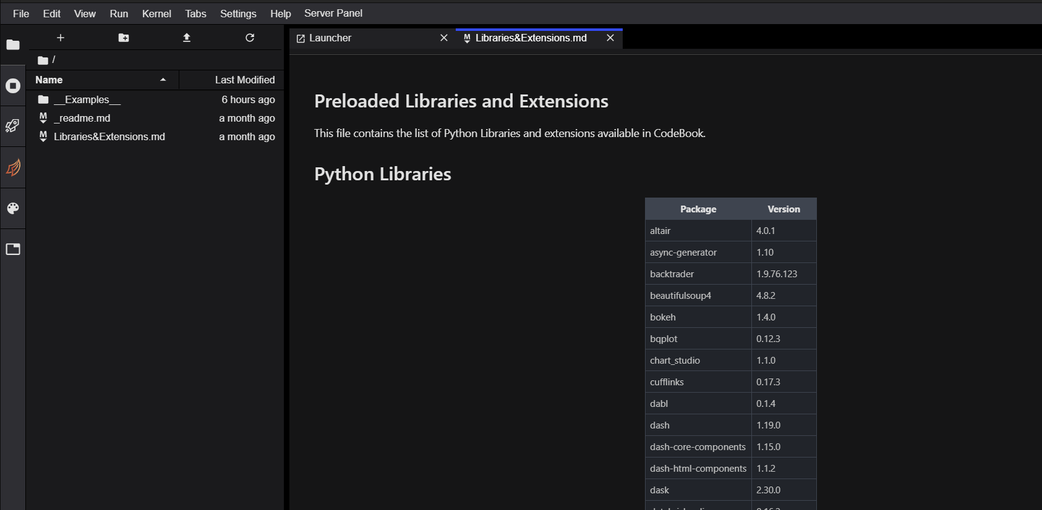
Available Python Libraries in Codebook
Codebook comes with 89 pre-installed Python libraries which includes the ones from the previous slide
Currently you cannot install new packages, however this will be enabled in the future versions.
The list of available libraries in Codebook can be found in the Libraries&Extensions.md file from left sidebar of Codebook

Slide 9
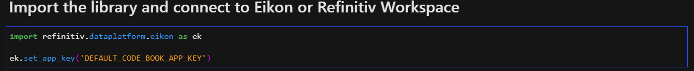
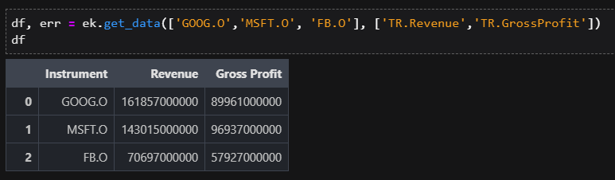
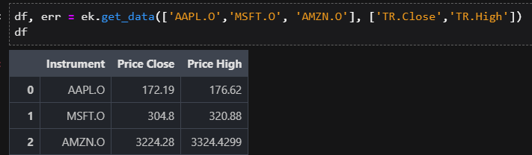
CodeBook Examples (RDP): Import and Run
First step of creating and running a code in Python using CodeBook is to import the required libraries and Connect to Eikon or Refinitiv Workspace using APP key. The process of generating APP key can be found here. The snippet below imports the Eikon library and connects to the API via the APP key.
Now as we are connected to the API service we can request some data from Eikon API.
This query takes Company RICs and requested fields, such as Revenue and Gross Profit as an input and returns the values in a Pandas dataframe.
In this query we change the RICs and requested fields, using Close and High price instead. The output dataframe is shown below.

Slide 10
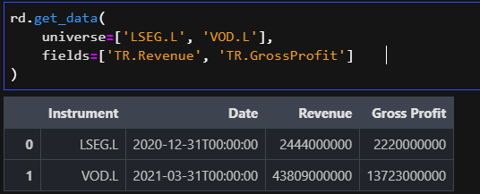
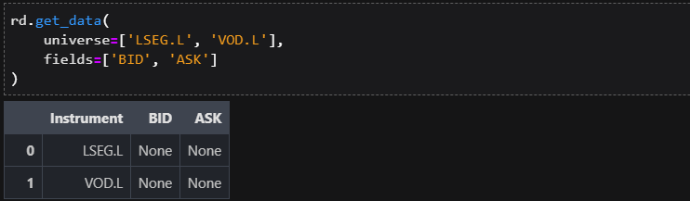
CodeBook Examples (RD Libraries): Import and Run
We can access the date via RD Libraries as well. For that we need to import the library and authorize ourselves (refinitiv-data.config.json file contains authorization keys).
Now as we are connected to the API service we can request some data from RD Library API.
This query takes Company RICs and requested fields, such as Revenue and Gross Profit as an input and returns the values in a Pandas dataframe.
In this query we change the RICs and requested fields, using Close and High price instead. The output dataframe is shown below.

Slide 11
More Code examples: Comment/Run/Find
Link to the Session video:
Links to other useful resources:
https://developers.refinitiv.com/en/article-catalog/article/use-eikon-data-api-or-rdp-library-python-codebook-web-browser
https://www.twitch.tv/johnukfr/schedule
https://developers.refinitiv.com/en/video-catalog/data-item-browser

